Slide 1
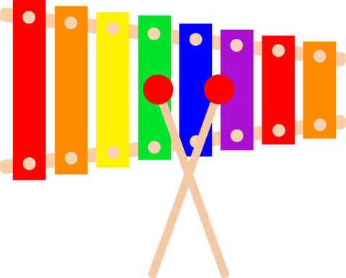
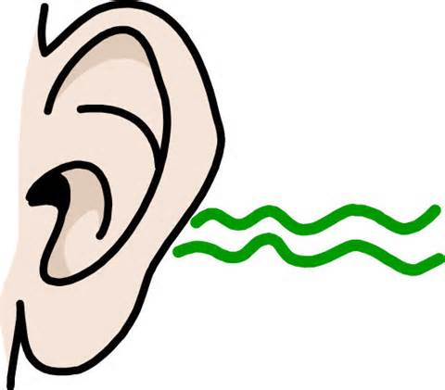
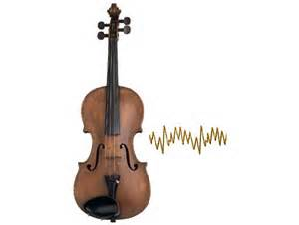
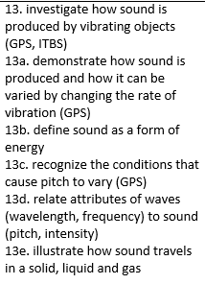
Sound Review
4th Grade Science – Askew
4th Grade AKS

Slide 2
SOUND
A form of energy caused by vibrations is called ________________.

Slide 3
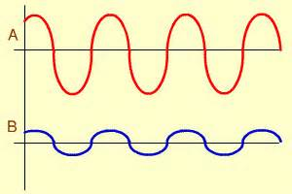
AMPLITUDE
_______________ is how loud a sound is or the height of the sound wave.
If the sound intensity is more, the ________ is more.
?

Slide 4
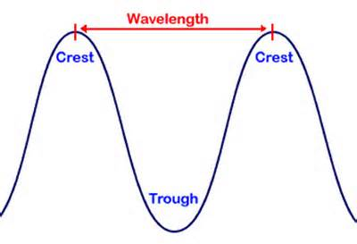
WAVELENGTH
A ____________ is the distance between the crest of one wave and the crest of the next.
?

Slide 5
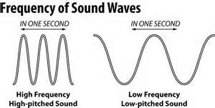
FREQUENCY
____________ is the number of complete waves that pass a given point in a certain amount of time.

Slide 6
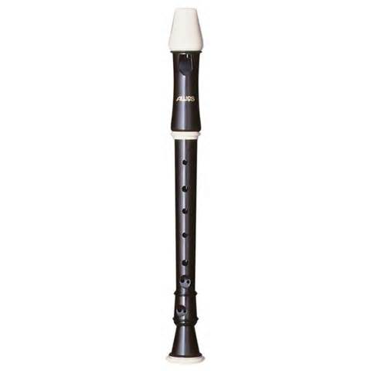
PITCH
___________ is the highness or lowness of sound.

Slide 7
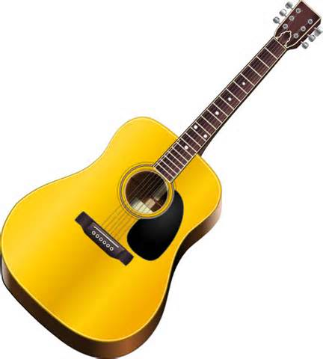
VIBRATIONS
Sounds are made by ______________.

Slide 8
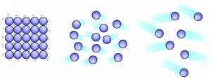
SOLID
Solid
Liquid
Gas
Sound travels the fastest through a ___________ because the molecules are packed very tightly together.

Slide 9
You cannot hear sound in space because sound waves cannot travel in a vacuum.
Can you hear sound in space? Why or why not?
?

Slide 10
Label the sound waves as high frequency or low frequency.
High Frequency
Low
Frequency

Slide 11
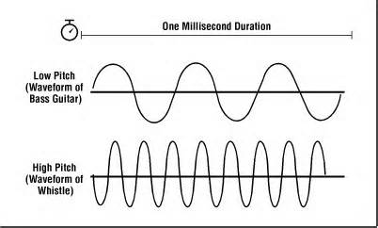
Which sound wave has the highest pitch?
?
?

