Slide 1
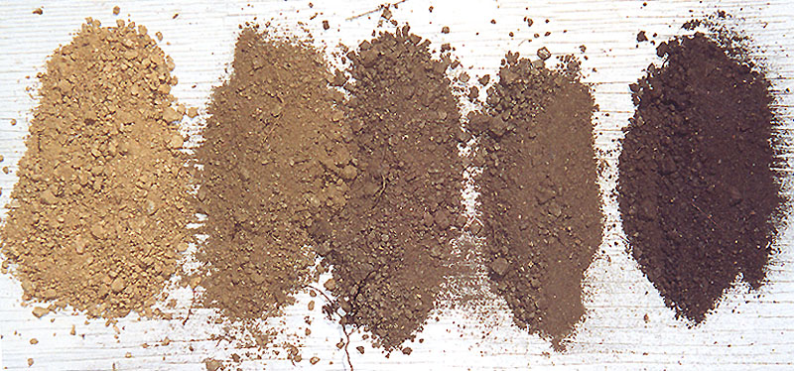
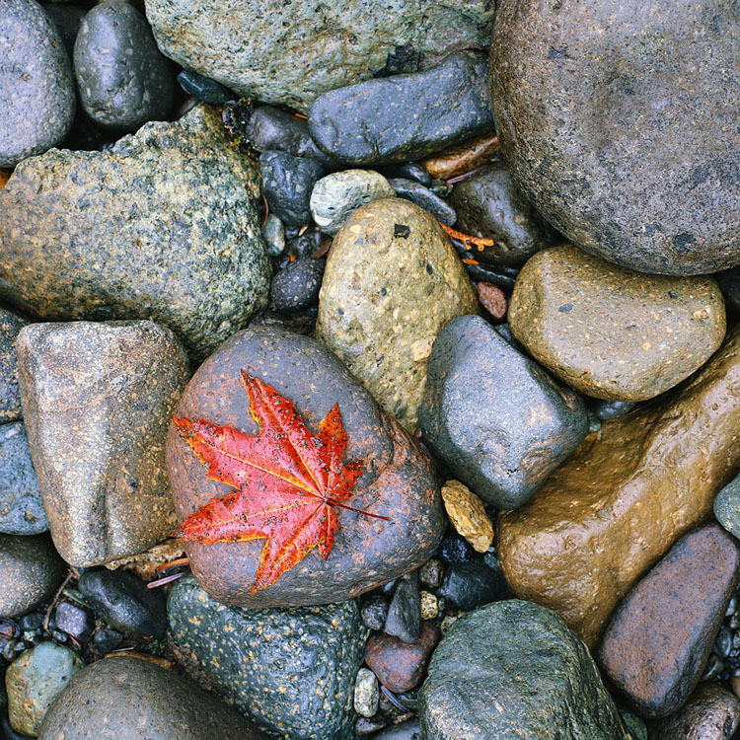
Rocks, Minerals, and Soil Review
3rd Grade Science AKS 8. investigate the physical attributes of rocks and soils (GPS, ITBS) 8a. compare and contrast rocks and minerals (GPS) 8b. determine the physical attributes of rocks and minerals using observations (shape, color, and texture), measurements, and simple tests (hardness) (GPS) 8c. compare and contrast the texture, particle size and color in top soils (clay, loam, potting soil, sand) using observational skills (GPS) 8d. classify rocks according to the manner in which they formed (igneous, sedimentary, metamorphic) (GPS) 8e. Determine how water and wind can change rocks and soil over time using observation and research (GPS)
3rd Grade Science Specials – Askew

Slide 2
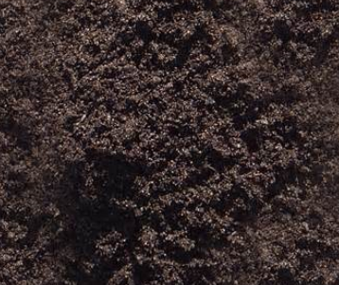
___________is a kind of dark soil with clay, sand, and humus. Plants grow best in this.

Slide 3
Loam
___________is a kind of dark soil with clay, sand, and humus. Plants grow best in this.

Slide 4
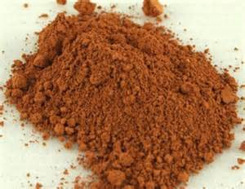
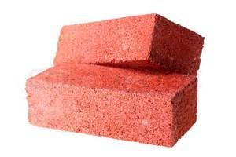
This type of soil has the smallest particle size, is very smooth in texture, and doesn’t let much water through it. It is sometimes used to make pottery or bricks.
_____?_____

Slide 5
This type of soil has the smallest particle size, is very smooth in texture, and doesn’t let much water through it. It is sometimes used to make pottery or bricks.
Clay

Slide 6
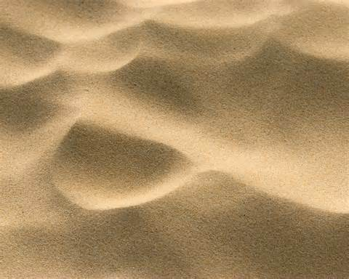
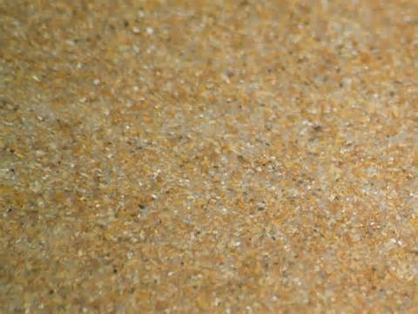
___________ is tiny grains of rock that make up deserts and beaches. It has the largest particle size, is rough, and holds the fewest nutrients. It lets a lot of water through.

Slide 7
Sand
___________ is tiny grains of rock that make up deserts and beaches. It has the largest particle size, is rough, and holds the fewest nutrients. It lets a lot of water through.

Slide 8
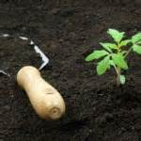
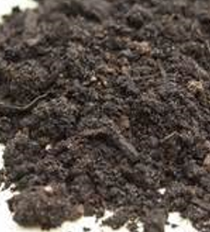
__________________ is the top layer of soil, contains humus, minerals, and can hold a lot of water.

Slide 9
Topsoil
__________________ is the top layer of soil, contains humus, minerals, and can hold a lot of water.

Slide 10

Material that was once living and adds nutrients to the soil is called _________________________.
The darker a soil is, the more nutrient rich it is.

Slide 11
Material that was once living and adds nutrients to the soil is called _________________________.
The darker a soil is, the more nutrient rich it is.
humus

Slide 12
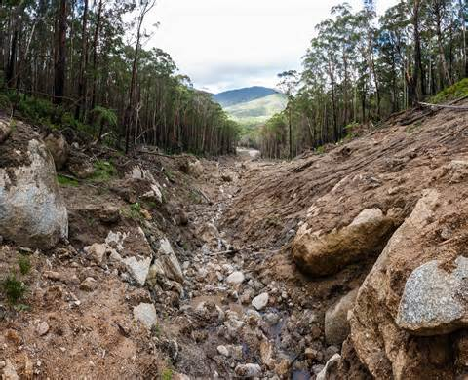
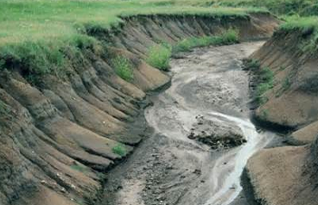
__________________ is the carrying away of sediments.

Slide 13
Erosion
__________________ is the carrying away of sediments.

Slide 14
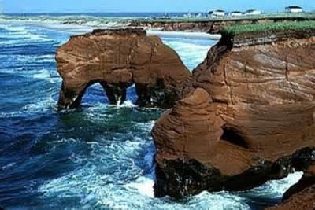
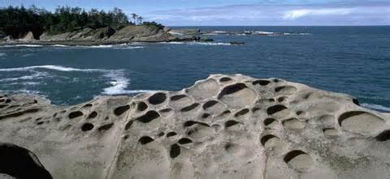
__________________ is the wearing down of rocks and minerals by water, ice, wind, and plant roots.

Slide 15
Weathering
__________________ is the wearing down of rocks and minerals by water, ice, wind, and plant roots.

Slide 16
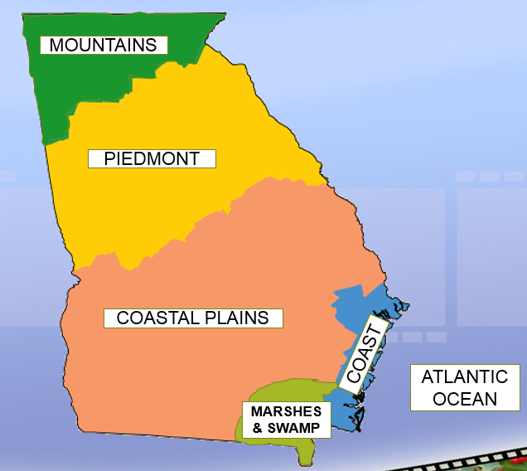
In which region of Georgia can you find the most red clay?

Slide 17
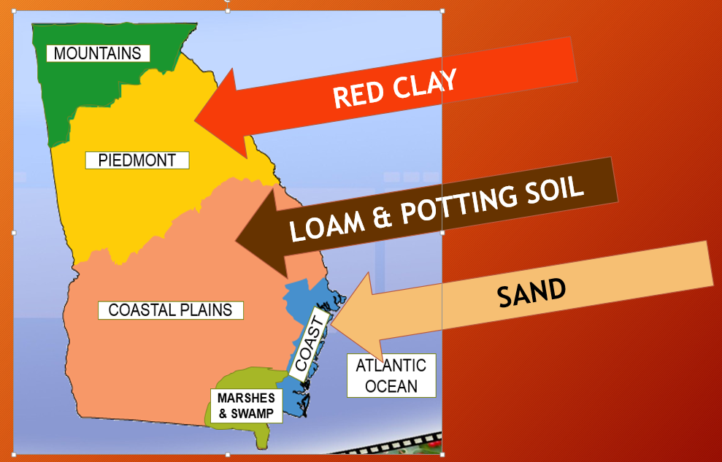
In which region of Georgia can you find the most red clay?

Slide 18
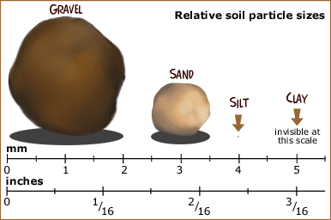
Where should sand and clay go on this scale?
Soil Particle Sizes
?
?

Slide 19
Where should sand and clay go on this scale?
Soil Particle Sizes
Sand
Clay

Slide 20
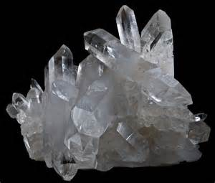
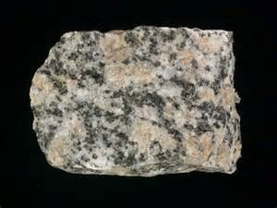
____?_____
Naturally occurring in Earth
Usually one color
Usually have a certain type of shape
No fossils
Which description shows the characteristics of minerals?
Which description shows the characteristics of rocks?
______?_____
Made up of two or more minerals
Different colors
No “regular” shape
Can sometimes include fossils

Slide 21
MINERALS
Naturally occurring in Earth
Usually one color
Usually have a certain type of shape
No fossils
Which description shows the characteristics of minerals?
Which description shows the characteristics of rocks?
ROCKS
Made up of two or more minerals
Different colors
No “regular” shape
Can sometimes include fossils

Slide 22
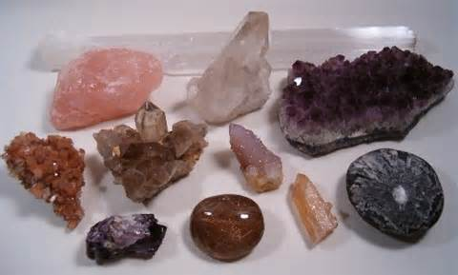
A _ T R I _ _ T E S are characteristics that describe minerals.
Examples: texture, streak, hardness, etc.

Slide 23
Attributes
__________________ are characteristics that describe minerals.
Examples: texture, streak, hardness, etc.

Slide 24
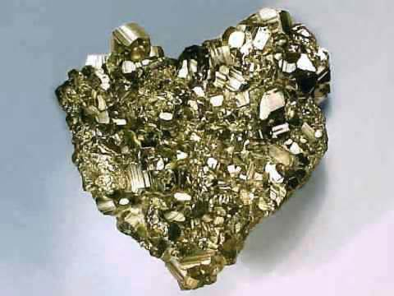
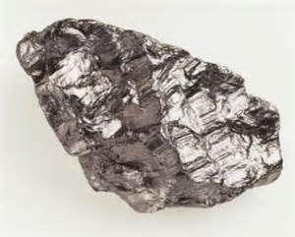
__________________ is how shiny a mineral appears.

Slide 25
Luster
__________________ is how shiny a mineral appears.

Slide 26
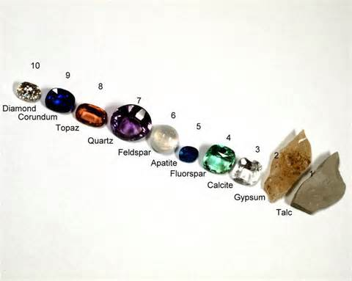
_______________________________________ is the name of the scale that rates the hardness of minerals.

Slide 27
Moh’s Hardness Scale
_______________________________________ is the name of the scale that rates the hardness of minerals.

Slide 28
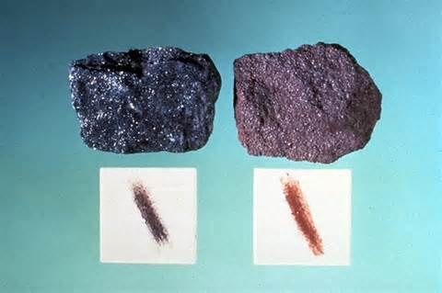
__________________ is the mark left on something from a mineral.

Slide 29
Streak
__________________ is the mark left on something from a mineral.

Slide 30
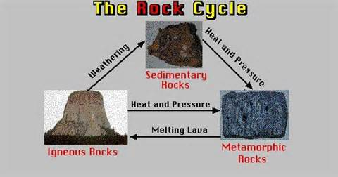
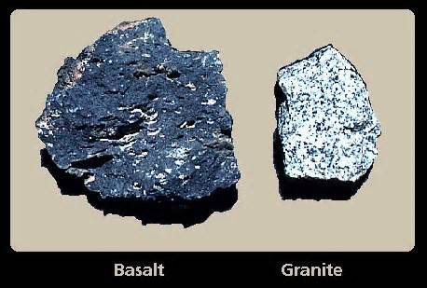


_____________________ is the type of rock that is fire-made and is formed when melted rock cools.

Slide 31
Igneous rock
_____________________ is the type of rock that is fire-made and is formed when melted rock cools.

Slide 32
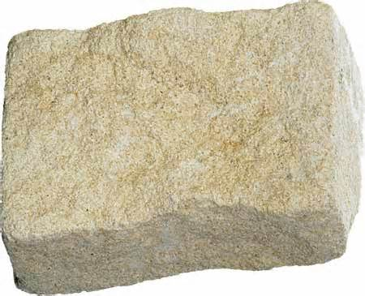
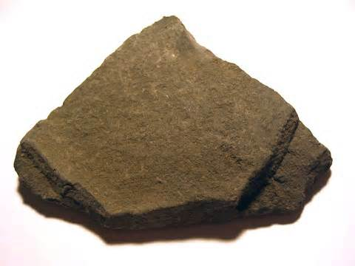
_____________________ is the type of rock that is formed when sand, mud, and pebbles pile up.
Limestone
Shale

Slide 33
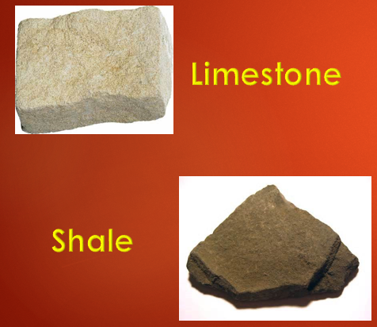
Sedimentary rock
_____________________ is the type of rock that is formed when sand, mud, and pebbles pile up.

Slide 34
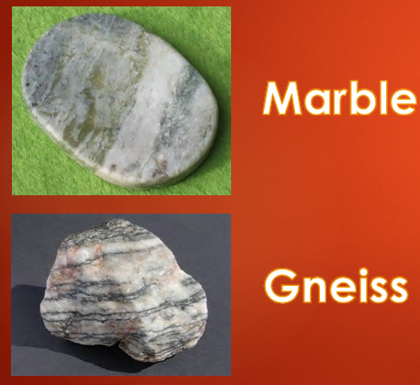
_____________________ is the type of rock that is changed through heating and squeezing.

Slide 35
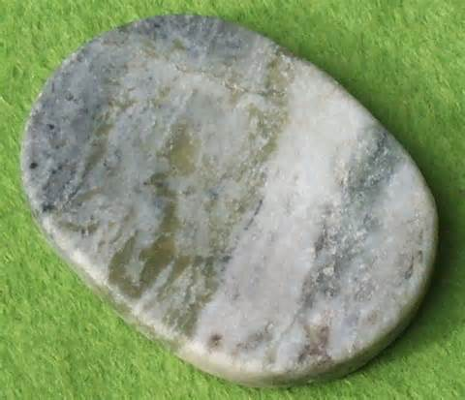
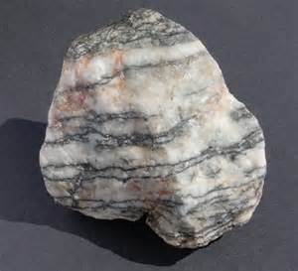
Metamorphic rock
_____________________ is the type of rock that is fire-made and is formed when melted rock cools
Marble
Gneiss

Slide 36
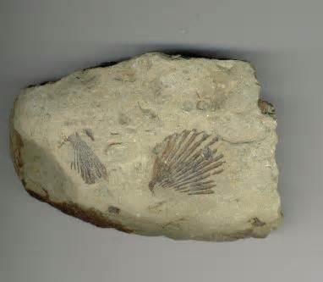
You can find fossils in this type of rock.
___?___

Slide 37
You can find fossils in this type of rock.
SEDIMENTARY ROCK

Slide 38
__________________ is the hardest mineral on the Moh’s Hardness Scale.
?

Slide 39
Diamond
__________________ is the hardest mineral on the Moh’s Hardness Scale.

