Slide 1
Matter
Chemical and Physical Changes Review
Ms. Askew – 5th Grade Science

Slide 2

The amount of matter in an object is its__________
MASS

Slide 3
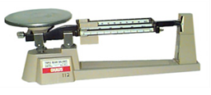
What tool do we use to measure mass?
Triple Beam Balance

Slide 4

grams

Slide 5
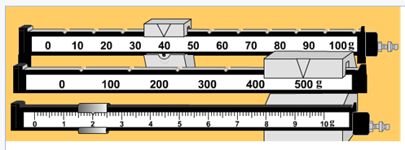
What is the mass of the object on this triple beam balance?
542 grams

Slide 6
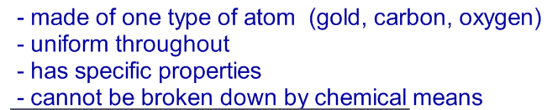
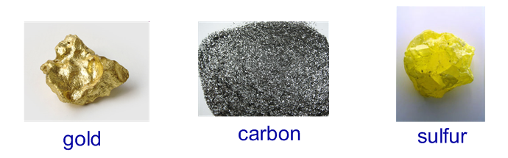
Elements
THESE ARE ALL ______________________

Slide 7
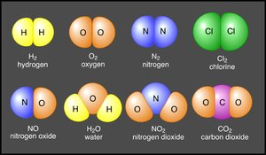
Two or more elements that are chemically combined make a _____________.
compound

Slide 8
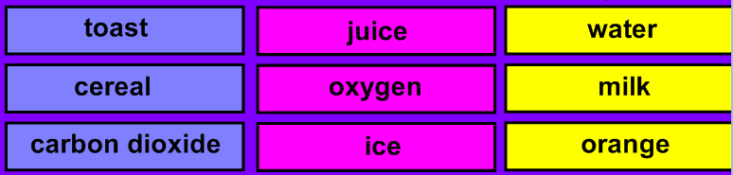





Is each example a solid, liquid, or gas?
nitrogen

Slide 9



LIQUID
DOES THE PICTURE SHOW THE MOVEMENT OF THE MOLECULES OF A SOLID, LIQUID, OR GAS?

Slide 10
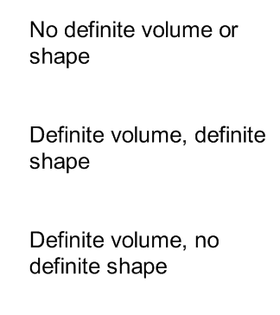
gas
solid
liquid
Remember that we CAN measure the volume of a liquid with a graduated cylinder.

Slide 11
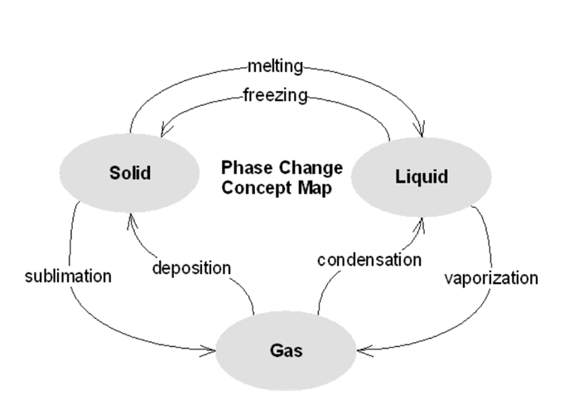

SOLID
LIQUID
?
GAS

Slide 12
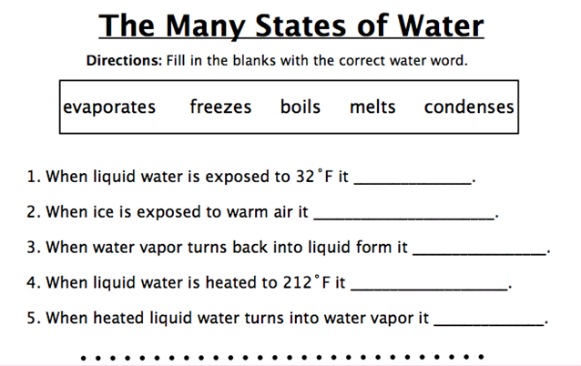
freezes
melts
condenses
boils
evaporates

Slide 13
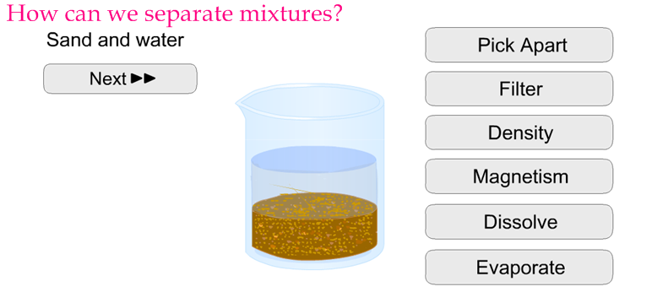
Evaporate
Filter

Slide 14
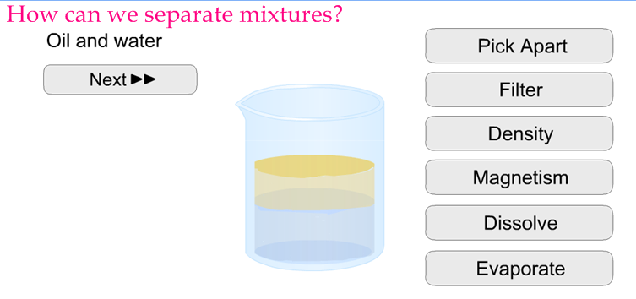

Density
Oil will float on top of water!

Slide 15
A _________ ________ is a change in state or by physical means.
The properties of the substance stay the same.
PHYSICAL CHANGE

Slide 16
A _________ ________ changes the chemical composition of the substance. Something new is made.
CHEMICAL CHANGE

Slide 17
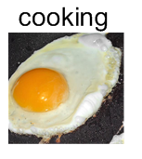




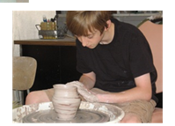
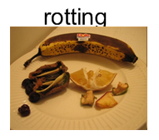
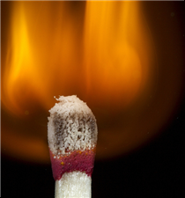
Does the example show a physical or chemical change?
Chemical
Physical
Tearing paper
Painting a house

Slide 18
TWO CLEAR LIQUIDS ARE MIXED. WHEN YOU MIX THEM, YOU NOTICE THAT THEY CREATE A YELLOW COLOR. YOU ALSO NOTICE THAT THE NEW MIXTURE IS GIVING OFF HEAT.
WHAT TYPE OF CHANGE DOES THIS EXAMPLE SHOW?
CHEMICAL CHANGE

Slide 19
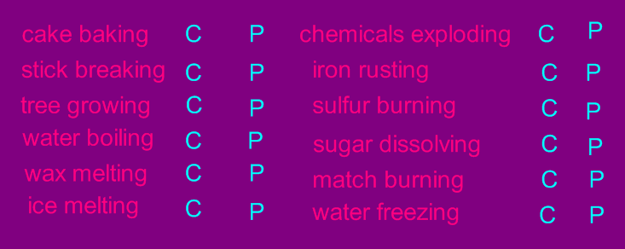

CHEMICAL OR PHYSICAL CHANGE???
All changes of state are PHYSICAL!

Slide 20
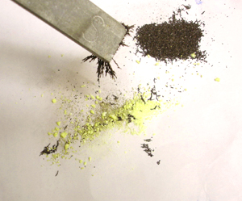

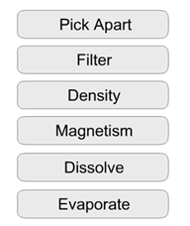
IRON AND SAND HAVE MIXED TOGETHER. WHAT IS THE BEST WAY TO SEPARATE THEM?

Slide 21
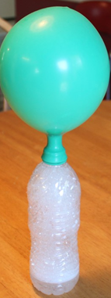
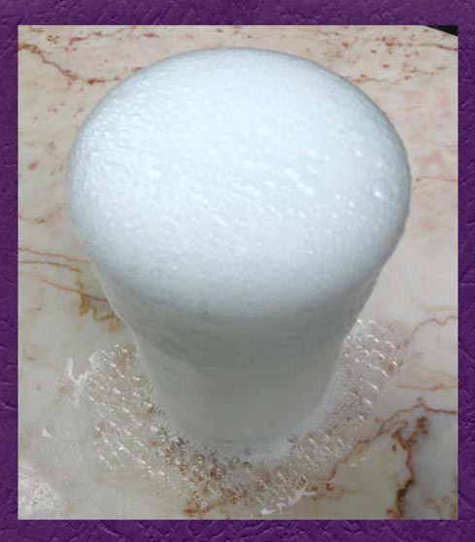
You mixed baking soda and vinegar in science class. Is this a chemical or physical change. How do you know?
A CHEMICAL CHANGE took place! A gas was created!
Bubbles/foam

