Slide 1
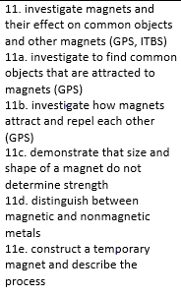
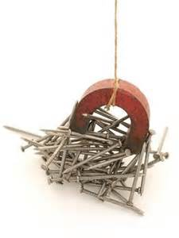
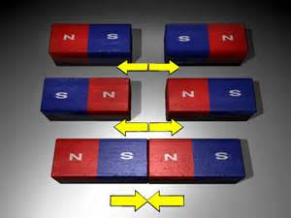
Magnetism Review
3rd Grade AKS
3rd Grade Science Specials - Askew

Slide 2
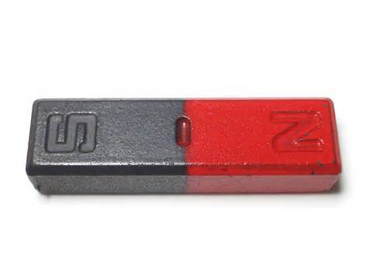
Magnet
Any material that attracts iron or metals containing iron.

Slide 3
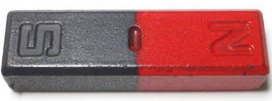
Permanent Magnet
This type of magnet is ALWAYS magnetized. It keeps its magnetism.

Slide 4
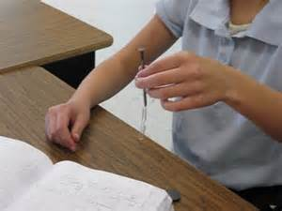
Temporary Magnet
This is made by rubbing an object made from soft iron, like a nail, against a permanent magnet. The magnetism will wear off over time.

Slide 5
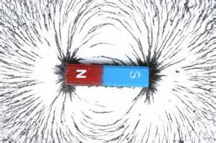
Magnetic Field
This is the area around a magnet where the force of a magnet can act.

Slide 6
Poles
The two ends of a magnet are the __________. The magnetic field is strongest here.

Slide 7
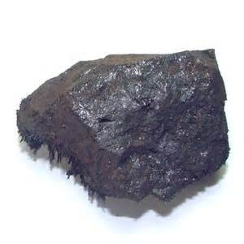
Magnetite/Lodestone
A type of rock containing iron deposits that is magnetic.

Slide 8
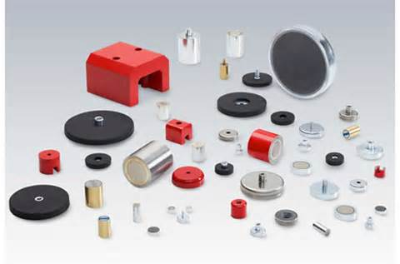
NO!
Does the size or shape of a magnet determine its strength?

Slide 9
attract
Label the diagram with repel or attract.
?
?
repel

Slide 10
?
iron
?
nickel
?
cobalt

Slide 11
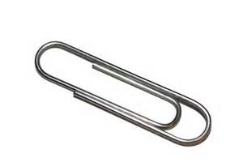
Is the material magnetic or nonmagnetic?

Slide 12
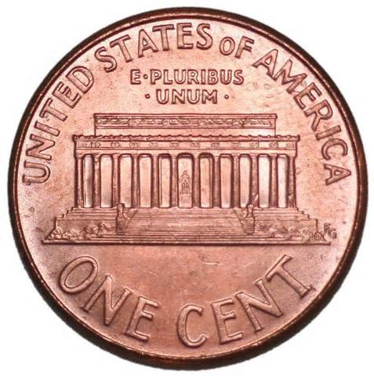
Is the material magnetic or nonmagnetic?

Slide 13
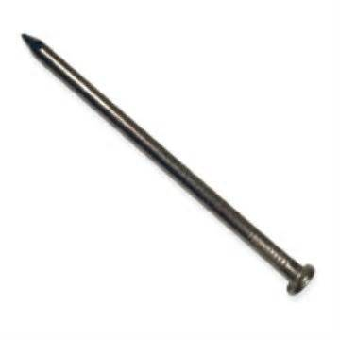
Is the material magnetic or nonmagnetic?

Slide 14
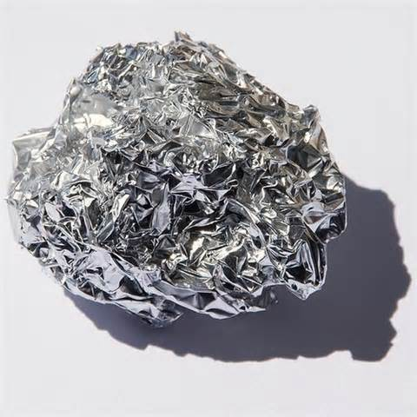
Is the material magnetic or nonmagnetic?

