Slide 1
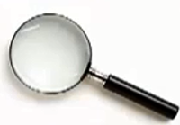
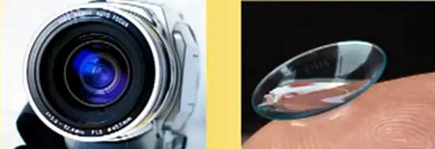
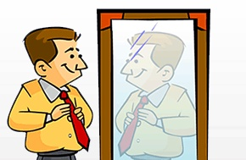
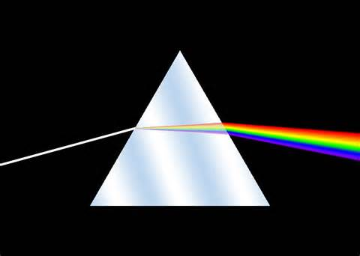
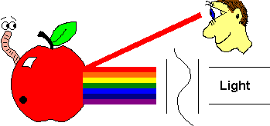
Light Review
4th Grade Science - Askew

Slide 2
For the first few questions, you will use a word bank to help you “fill in the blank.”
light prism wavelength spectrum
reflection refraction lenses
convex lens concave lens
opaque transparent translucent

Slide 3
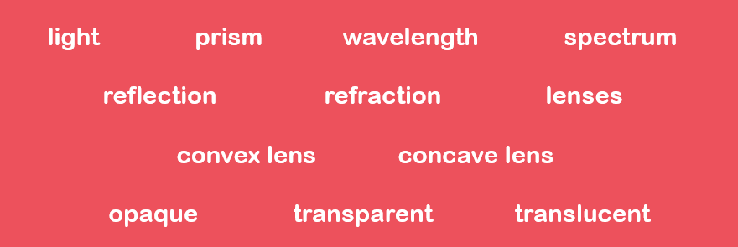
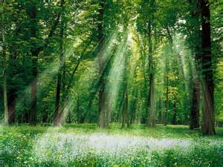
___________ is a form of electromagnetic energy.

Slide 4
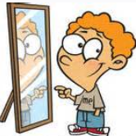
_____________ happens when light bounces off of a surface at an angle.

Slide 5
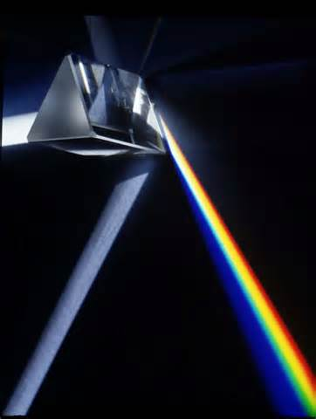
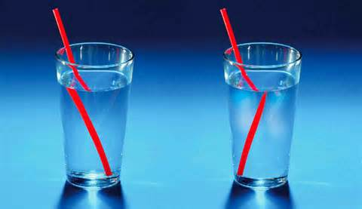
___________ is the bending of light.

Slide 6
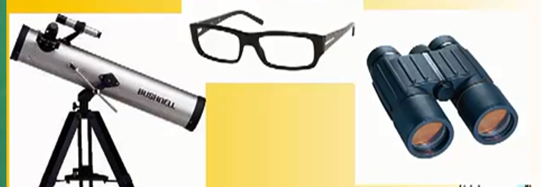
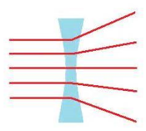
In a ______________, light rays are spread apart and curve inward.

Slide 7
The visible ____________ is the range of light waves with different wavelengths and energies.

Slide 8
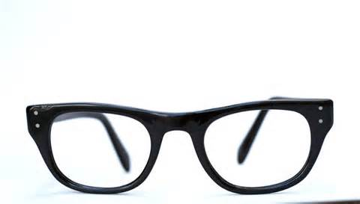
___________ are tools that refract (or bend) light.

Slide 9
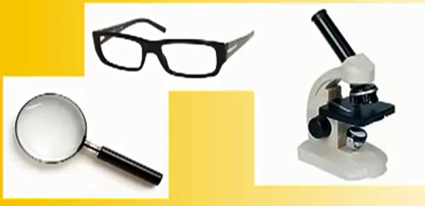
In a _______________, light rays are brought together at a focal point and bulge in the middle.

Slide 10
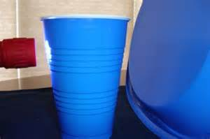
Objects that block all light are called _________________.

Slide 11
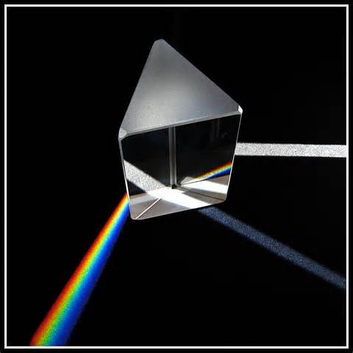
A ___________ is an objet that separates white light and bends it into the colors that make it up.

Slide 12
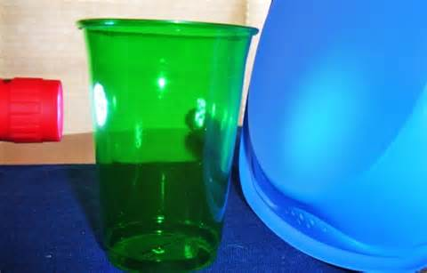
Objects that allow some light to pass through and may look blurry are called _____________.

Slide 13
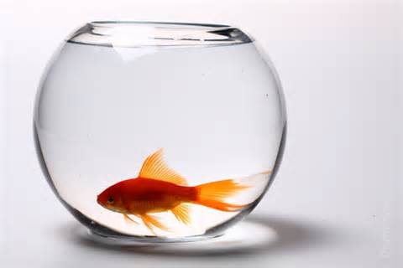
Objects that allow light to pass through them and are things like glass or clear plastic are called ______________.

Slide 14
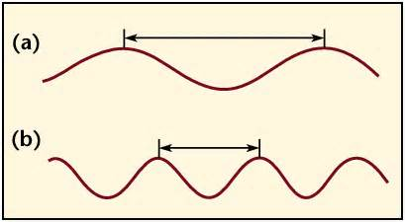
The distance from the top of one wave to the top of another wave is called the _________________.

