Slide 1

Ms. Askew – 5th Grade Science

Slide 2
An animal with a backbone
Examples: fish, amphibian, reptile, bird, mammal
Vertebrate

Slide 3
Animals that have bodies that produce their own heat
Examples: birds and mammals
Warm-blooded animals

Slide 4
Vertebrates that have live young, are covered with fur or hair, and are warm-blooded
Exceptions: The spiny anteater and platypus lay eggs.
Mammals

Slide 5
An animal without a backbone
Examples: snail, coral, sponge, ant butterfly, octopus
Invertebrate

Slide 6
Animals that have bodies that are the same temperatures as their surroundings
Examples: fish, amphibians, reptiles
Cold-blooded
animals

Slide 7
Vertebrates that have scales and fins and are cold-blooded
They live in water.
Examples: sharks, salmon, trout and tuna
Fish

Slide 8
Vertebrates that are warm-blooded and covered in feathers
Examples: eagle, penguin, duck, pelican
Birds

Slide 9
These vertebrates start life with gills and develop lungs. They are cold-blooded and have smooth, moist skin.
Examples: frogs, toads, salamanders
Amphibians

Slide 10
Vertebrates that are cold-blooded and covered in scales
Examples: snakes, lizards, alligators and crocodiles
Reptiles

Slide 11
Plants that have tubes to carry food and water
Examples: conifers, oaks, roses, sunflowers, orchids
Vascular Plants

Slide 12
Plants that do not have tubes and absorb food and water directly from the soil
Nutrients move cell to cell
Examples: mosses, liverworts, hornworts
Nonvascular

Slide 13
A Multicellular organism that feeds on dead organisms
Examples: molds, yeasts, mushrooms
Fungi

Slide 14
Cells in seedless plants that grow into new organisms
Examples: Ferns, hornworts and mosses reproduce this way
Spores

Slide 15
A trait that is passed down from parent to offspring
Examples: freckles, dimples, hair color, animal instincts
Inherited Trait

Slide 16
These contains traits.
They contain instructions that control an organism’s growth.
Genes

Slide 17
The young or baby of two parents
Offspring

Slide 18
Behaviors that are taught through experience or watching others.
Examples: reading, playing the piano
Learned Behaviors

Slide 19
These structures are found in pairs in the nucleus that hold the information from our parents.
Humans have 46 in all and 23 pairs.
Chromosomes

Slide 20
Jelly-like substance in plant and animal cells that holds the organelles.
Cytoplasm

Slide 21
Structures found in plant cells that produce food for the plant through photosynthesis
Chloroplasts

Slide 22
Thin layer that allows water and nutrients to pass into and out of the cell
The GAtekeeper
Cell Membrane

Slide 23
This is the part of the cell that control’s the cell’s functions and growth.
This is where the genetic material is located.
Nucleus

Slide 24
This protects plant cells and helps give the plants their shapes
Cell Wall

Slide 25
These are living things that are too small to see without a microscope. Some are helpful and some are harmful.
Microorganisms

Slide 26
MIRCROORGANISMS are living things that are too small to see without a microscope. Some are helpful and some are harmful.
Directions: Tell whether each example below is “harmful” or “Beneficial”
Keep clicking to reveal answers…
Yeast is used to make bread rise
Bacteria can cause tetanus, a serious infectious disease.
A fungus is used to make riboflavin, an important vitamin for our bodies.
Microbes cause food to spoil.
BENEFICIAL
HARMFUL
BENEFICIAL
HARMFUL
Bacteria are decomposers and help break down waste.
Microbes are used to clean up oil spills.
Bacteria can cause food poisoning
BENEFICIAL
HARMFUL
BENEFICIAL

Slide 27
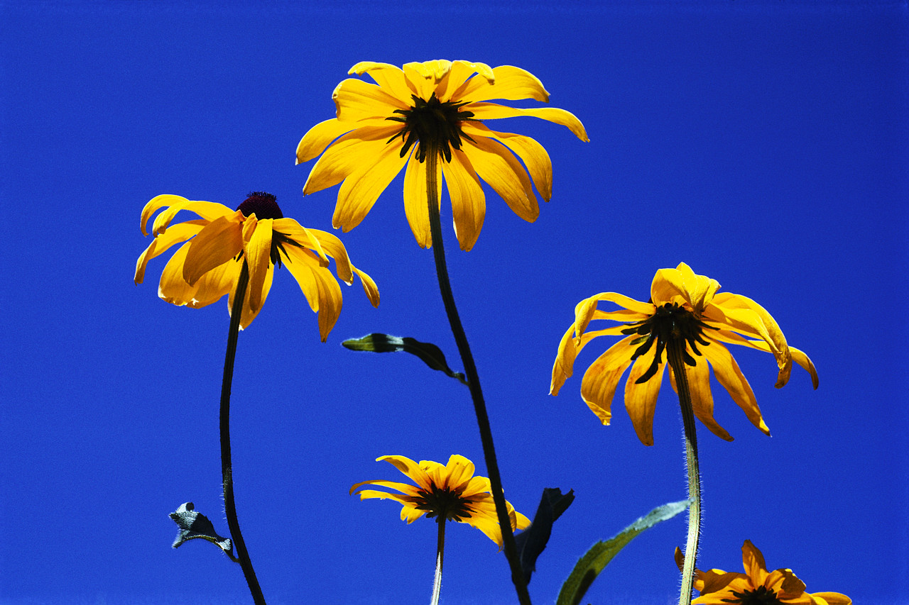
What are plants called that produce fruits and flowers?
Angiosperms

Slide 28
What two cell parts are only found in plant cells?
Chloroplast
Cell Wall

Slide 29
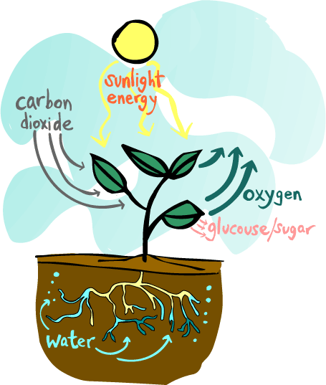
plants get their food through a process called _________________.
Photosynthesis

Slide 30
What is the way organisms are classified from most broad to most specific?
Kingdom
Phylum
Class
Order
Family
Genus
Species
HINT: Supercalifragilisticexpialidocious

Slide 31
What is the term given to organisms with many cells?
Examples: some protists, Most fungi, birds, mammals
Multicellular

Slide 32
What is the term given to organisms with only one cell?
This one cell does everything it needs to live
Examples: all bacteria, most protists
Unicellular
or
Single-celled organisms

Slide 33
an arthropod is an invertebrate that has jointed legs, a segmented body, and an external skeleton. What is this external skeleton called?
Exoskeleton

Slide 34
how many legs do insects have?
6

Slide 35
how many legs do spiders have?
8

Slide 36
Are there more invertebrates or vertebrates on earth?
Invertebrates

Slide 37
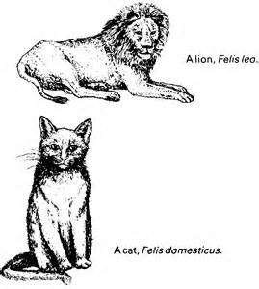
Scientists use binomial nomenclature to give animals their names. What two parts of the classification system are used to give animals their names?
Genus and species

Slide 38
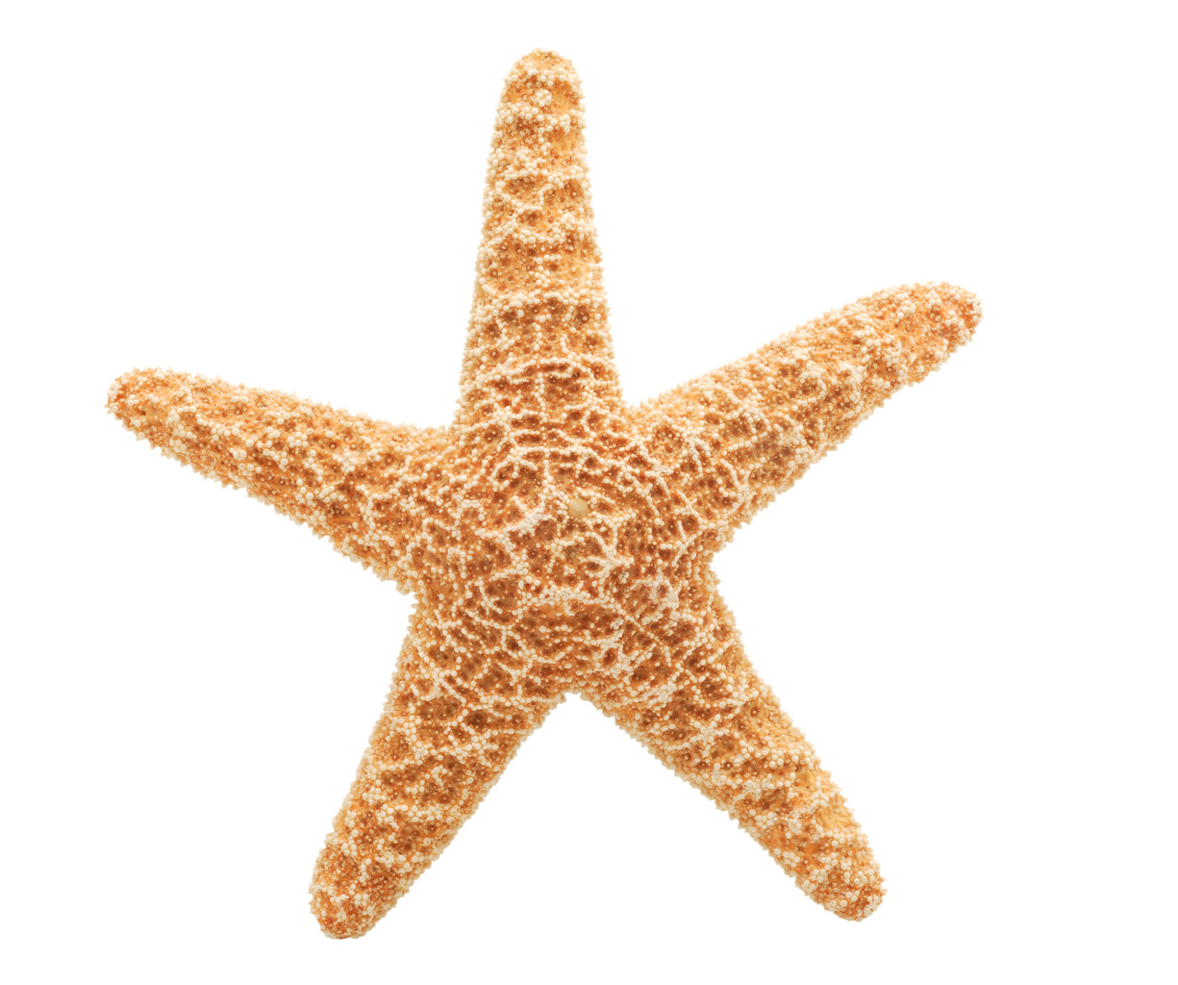
for each example, tell if it is an invertebrate or vertebrate.
Keep clicking to view the answers! ☺
Coral
Sea Star
Ladybug
Salmon
Dog
Butterfly
Sponge
Octopus
Toad
Whale
Human
Spider
Falcon
Earthworm
Shark
Invertebrate
Invertebrate
Vertebrate
Invertebrate
Invertebrate
Invertebrate
Invertebrate
Invertebrate
Vertebrate
Vertebrate
Vertebrate
Invertebrate
Vertebrate
Vertebrate
Vertebrate

Slide 39
LET’s play name that class!
Directions: View each example or description and name its vertebrate class fish, amphibians, reptiles, birds, mammals

Slide 40
this class of vertebrates has hollow bones
Birds

Slide 41
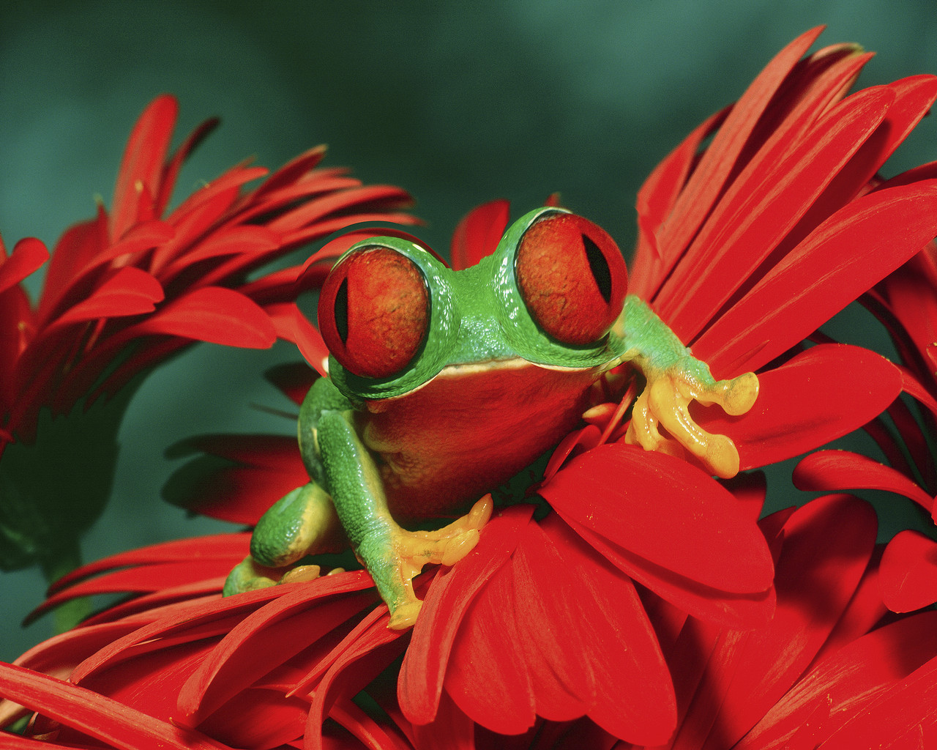
frog
Amphibian

Slide 42
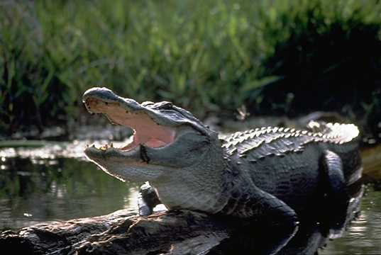
alligator
Reptile

Slide 43
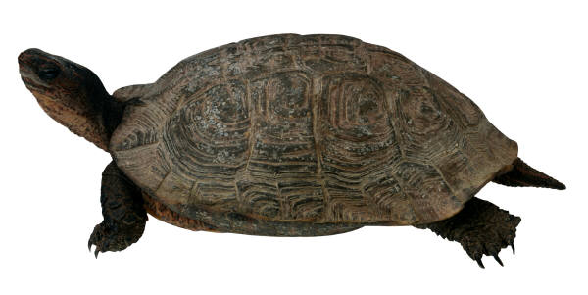
turtle
Reptile

Slide 44
whale
Mammal

Slide 45
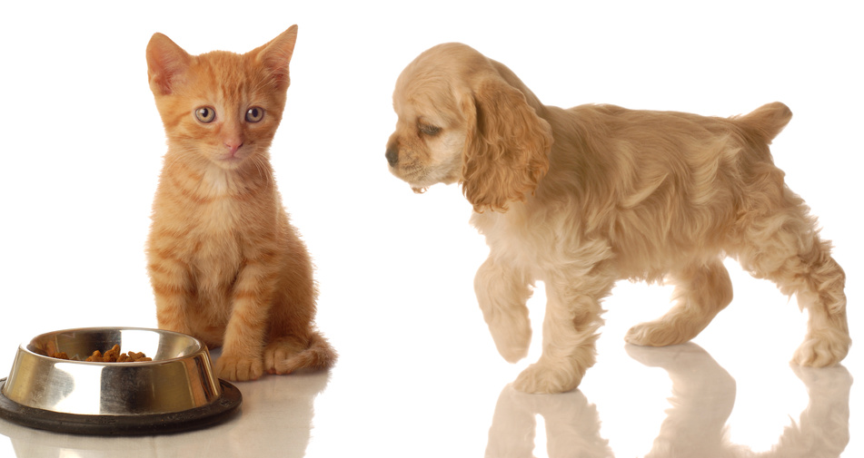
young are born alive and fed with milk produced in mammary glands
Mammal

Slide 46
human
Mammal

Slide 47
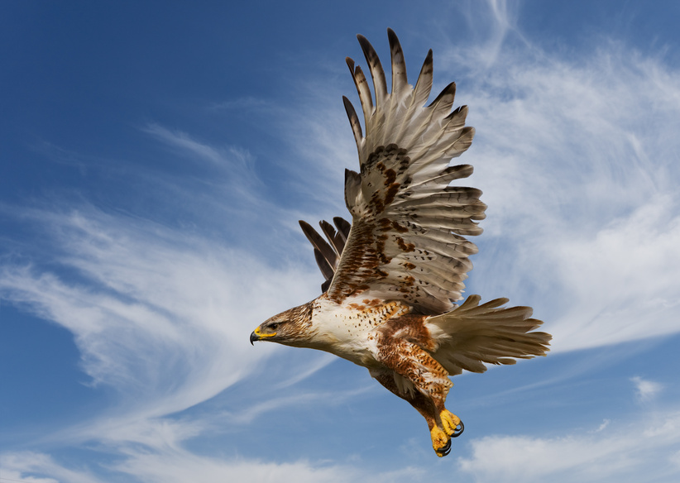
hawk
Bird

Slide 48
Gets oxygen from the water through gills lays eggs
Fish

Slide 49
scaly, dry skin lay eggs
Reptiles

Slide 50
smooth, moist skin
Amphibian

Slide 51
feathers four-chambered heart lays eggs
Birds

Slide 52
trout
Fish

Slide 53
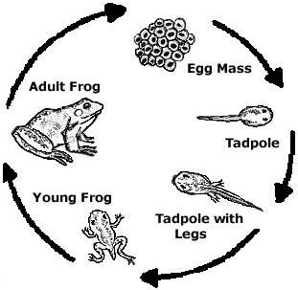
Has a “double Life” = part of its life is spent in the water and the other part on land
Amphibian

Slide 54
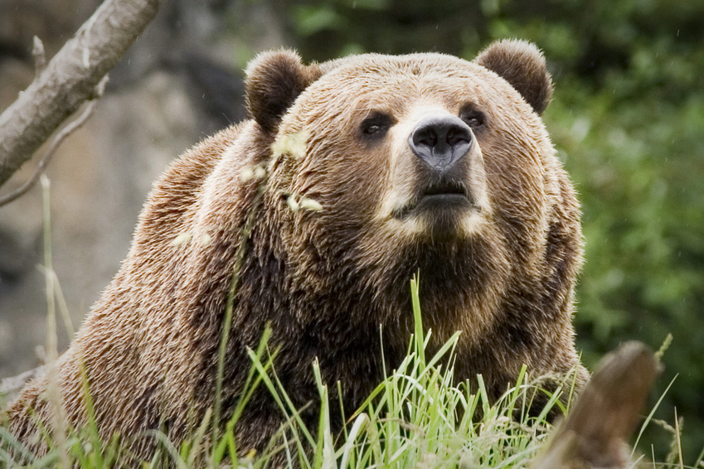
has hair or fur and a four-chambered heart
Mammals

Slide 55
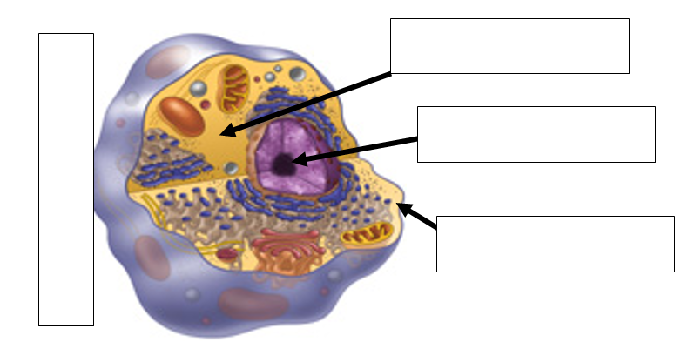
Ms. Askew presents: Name that cell part!
CYTOPLASM
NUCLEUS
ANIMAL CELL
CELL MEMBRANE

Slide 56
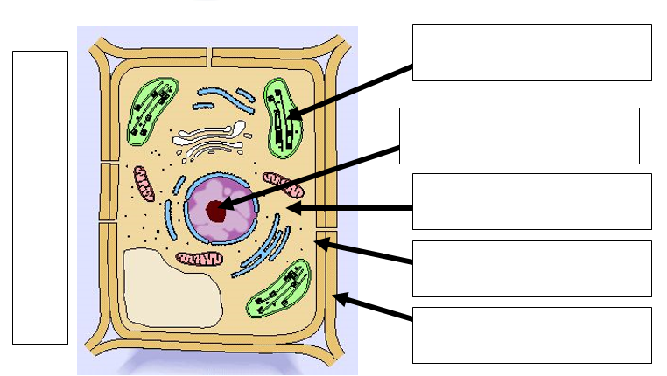
Ms. Askew presents: Name that cell part!
CHLOROPLAST
NUCLEUS
PLANT CELL
CYTOPLASM
CELL MEMBRANE
CELL WALL

Slide 57
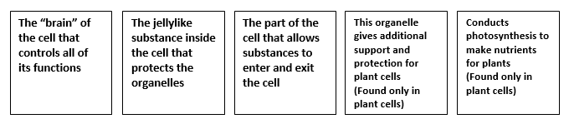
Ms. Askew presents: Name that cell part!
NUCLEUS
CYTOPLASM
CELL MEMBRANE
CELL WALL
CHLOROPLASTS

Slide 58







Name each example as an INHERITED TRAIT or LEARNED BEHAVIOR.
Inherited Trait
Learned Behavior
Learned Behavior
Riding a bike
Inherited Trait
Learned Behavior
Inherited Trait
Hair Color
Inherited Trait
Inherited Trait
Inherited Trait – Animal Instinct
Hibernation
Learned Behavior
Inherited Trait – Animal Instinct
Inherited Trait
Playing the piano
Birds building nests
Freckles
Learned Behavior
Inherited Trait
Multiplication

