Slide 1
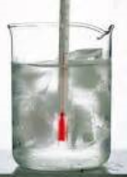
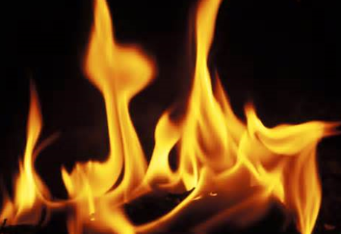
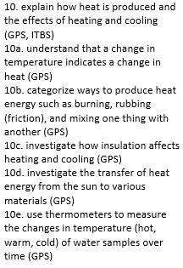
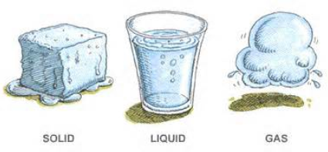
Heat Review
3rd Grade AKS
3rd Grade Science Specials - Askew

Slide 2
The instrument used to measure temperature is called a _____________.

Slide 3
The instrument used to measure temperature is called a _____________.
thermometer

Slide 4
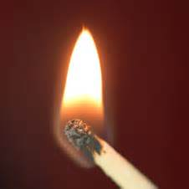
_______ is a form of energy that makes matter warmer.

Slide 5
_______ is a form of energy that makes matter warmer.
Heat

Slide 6
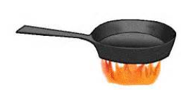
A ______________ is a material that heat moves through easily. It gets hot quickly.

Slide 7
A ______________ is a material that heat moves through easily. It gets hot quickly.
conductor

Slide 8
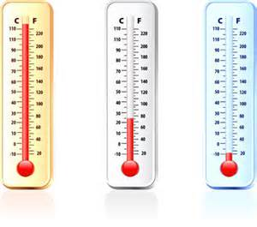
______________ is the measure of how hot or cold an object is.

Slide 9
______________ is the measure of how hot or cold an object is.
Temperature

Slide 10
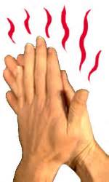
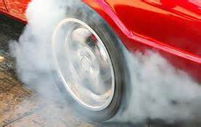
______________ is a source of heat when one object rubs against another.

Slide 11
______________ is a source of heat when one object rubs against another.
Friction

Slide 12
Molecules of an object get cooler and move slowly. They get smaller. They _________.

Slide 13
Molecules of an object get cooler and move slowly. They get smaller. They _________.
contract

Slide 14
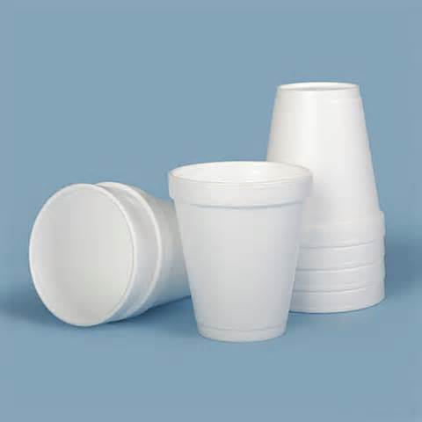
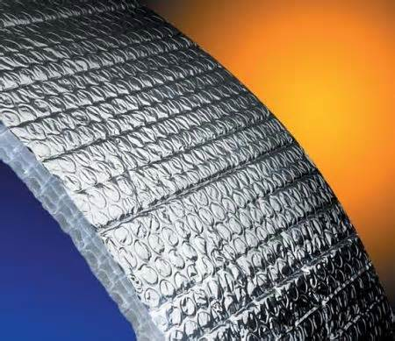
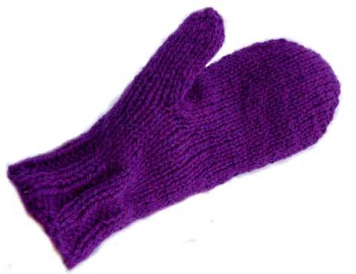
An ___________ is a material that prevents or slows down the transfer of heat. It keeps hot things hot and cold things cold.

Slide 15
An ___________ is a material that prevents or slows down the transfer of heat. It keeps hot things hot and cold things cold.
insulator

Slide 16
HEAT flows from _________ objects to _________ ones.

Slide 17
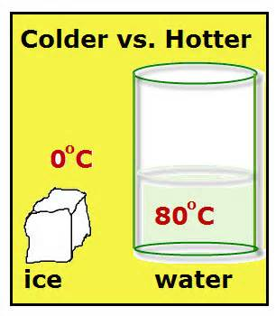
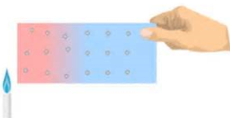
HEAT flows from _________ objects to _________ ones.
warmer
cooler

Slide 20
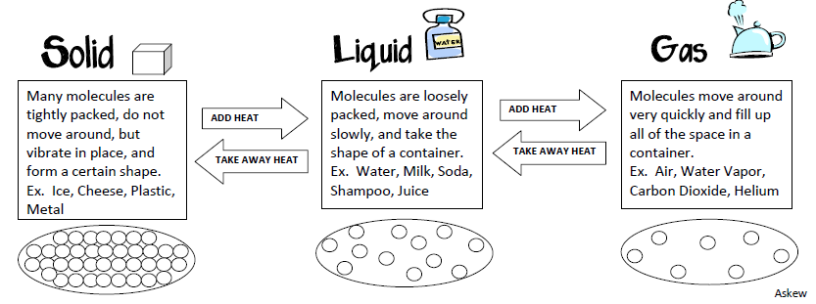

Slide 21
SOLID
LIQUID
GAS

