Slide 1
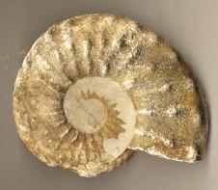
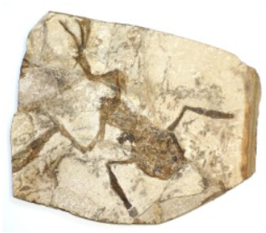
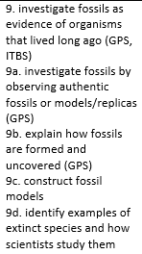
Fossils Review
3rd Grade AKS
3rd Grade Science Specials - Askew

Slide 2
This is an imprint or the remains of something that lived long ago.

Slide 3
FOSSIL
This is an imprint or the remains of something that lived long ago.

Slide 4
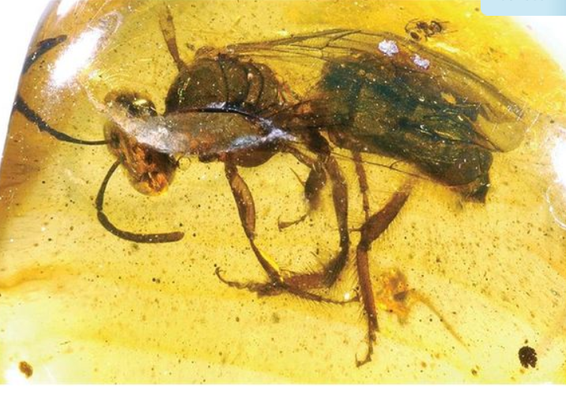
This is hardened tree sap that is usually a yellow color.

Slide 5
AMBER
This is hardened tree sap that is usually a yellow color.

Slide 6
Any living thing is called an __________________.

Slide 7
Any living thing is called an ORGANISM.

Slide 8
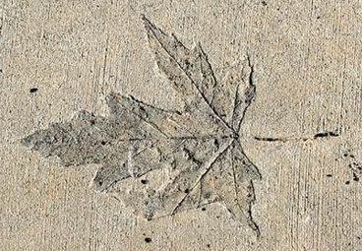
This is a shallow print or mark in solid rock.

Slide 9
IMPRINT
This is a shallow print or mark in solid rock.

Slide 10
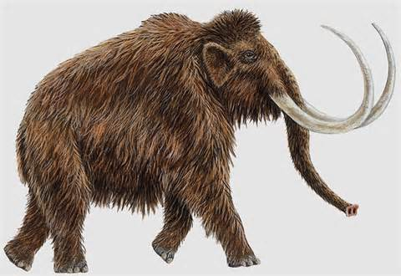
When a plant or animal no longer exists, it is __________.

Slide 11
EXTINCT
When a plant or animal no longer exists, it is EXTINCT.

Slide 12
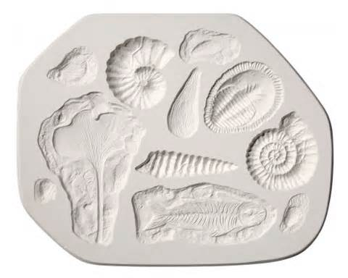
This is the empty space in rock where something once was.

Slide 13
MOLD
This is the empty space in rock where something once was.

Slide 14
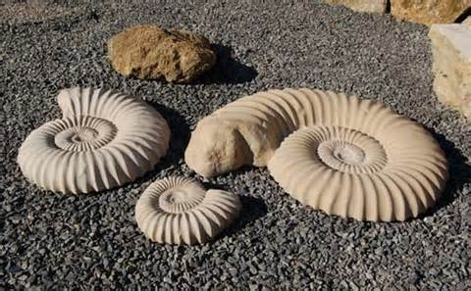
This is the fossil that is made inside a mold when minerals seep into it.

Slide 15
CAST
This is the fossil that is made inside a mold when minerals seep into it.

Slide 16
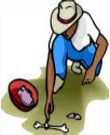
A scientist who studies fossils is called a _____________.

Slide 17
Paleontologist
A scientist who studies fossils is called a PALEONTOLOGIST.

Slide 18
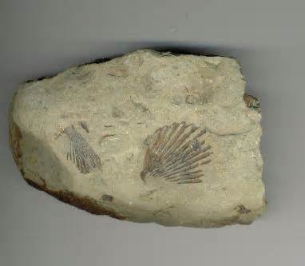
You can find fossils in this type of rock.
___?___

Slide 19
You can find fossils in this type of rock.
SEDIMENTARY ROCK

